Slide 1
Capstone Project
Title of the project: Magento Luma Website
https://magento.softwaretestingboard.com

Slide 2
AUTOMATION TESTING FOR LUMA
Introduction:
The Automation Testing Capstone Project focused on the website marked as significant milestone in the participants' learning journey. The project provided an opportunity to apply knowledge and skills acquired during the automation testing training, incorporating Selenium, TestNG, Cucumber, Apache POI, a hybrid framework, and advanced reporting tools like Allure/Extent. The objective is to create a comprehensive automation testing solution, fostering practical experience and showcasing participants' abilities to potential employers.
Modern PowerPoint Presentation

Slide 3
Problem Statement & Expectation:
In an online shopping/pet portal, where participants are going to work on different projects. Where user can register, login and buy any of the available items. Users can search for the item and add to the cart. Update the cart with quantity or with another item if required and make the payment. Objective is to Automate these workflows using Selenium with TestNG, Page Object Model and getting the data from data sheet/properties file. There by, we are testing faster and accurate using automation technique.

Slide 4
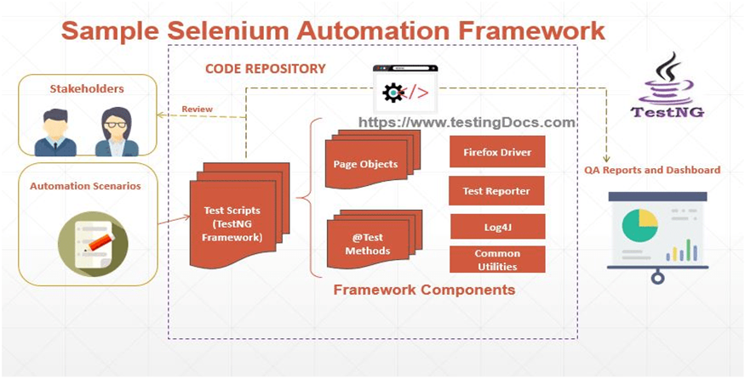
OUR JOURNEY WITH AUTOMATION:
Selenium
Page Object Model
Page Factory
Cucumber BDD
TestNG
Allure Report
Extent Report

Slide 5
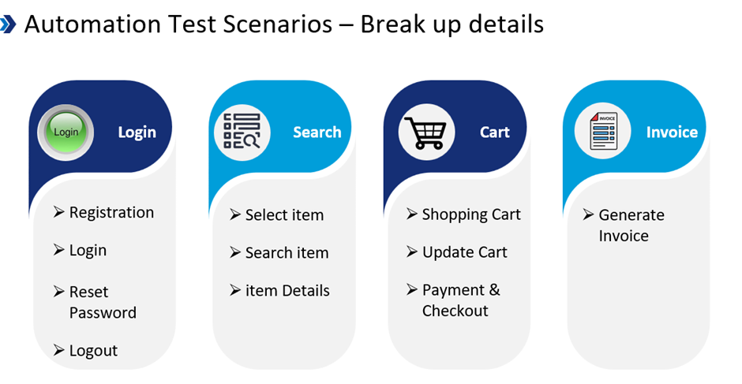
TEST SCENARIO MODULES:

Slide 6
Project Title: <Magento Luma>
Objective: The central aim of this capstone project is to construct a durable and streamlined test automation framework for evaluating the E-commerce/learning store. The framework integrates Selenium, BDD-Cucumber, Apache POI, Hybrid methodology, reporting tools and basic API Testing.
Test Flow:
Scenario 1: Registration
Scenario 2: Login
Scenario 3: Add to Cart
Scenario 4: Adding Multiple Products To Cart
Scenario 5: Checkout
Scenario 6: Logout

Slide 7
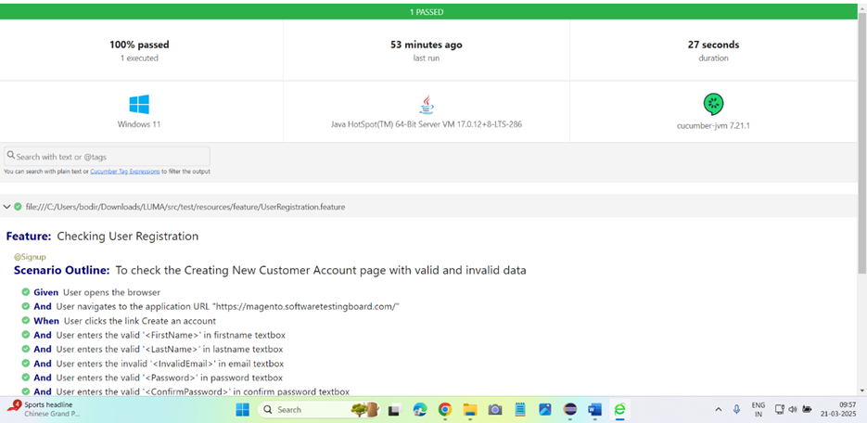
Scenario 1: Registration for Luma website with valid and invalid login using Cucumber BDD framework using POM, and generating allure reports.
OUTPUT: Cucumber Reports:

Slide 8
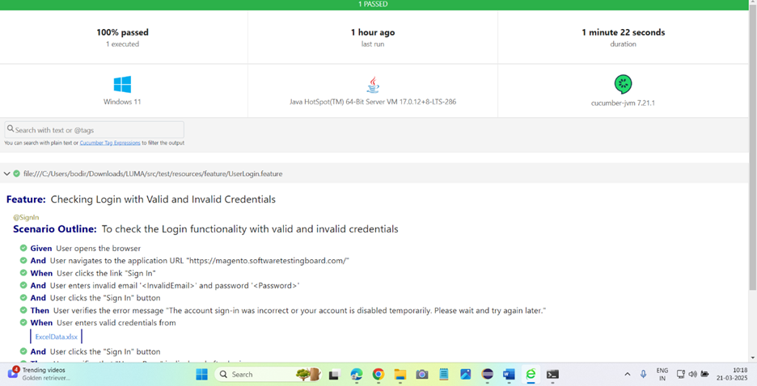
Scenario 2: Designed Cucumber framework for Login successful using POM, Data Properties, tags, hooks and generated extent reports.
OUTPUT: Cucumber Reports:

Slide 9
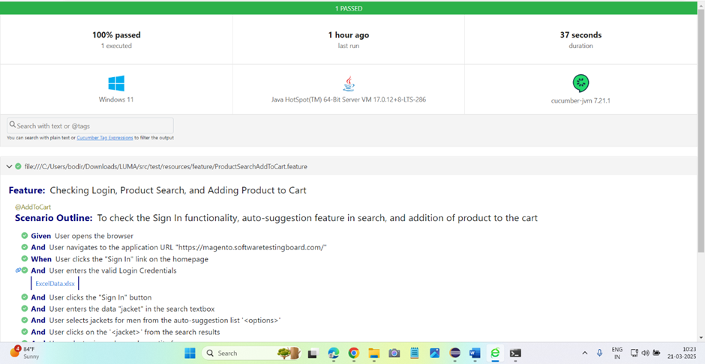
Scenario 3: Add to Cart using Cucumber Framework, POM, Data properties, generate allure reports.
OUTPUT: Cucumber Reports:

Slide 10
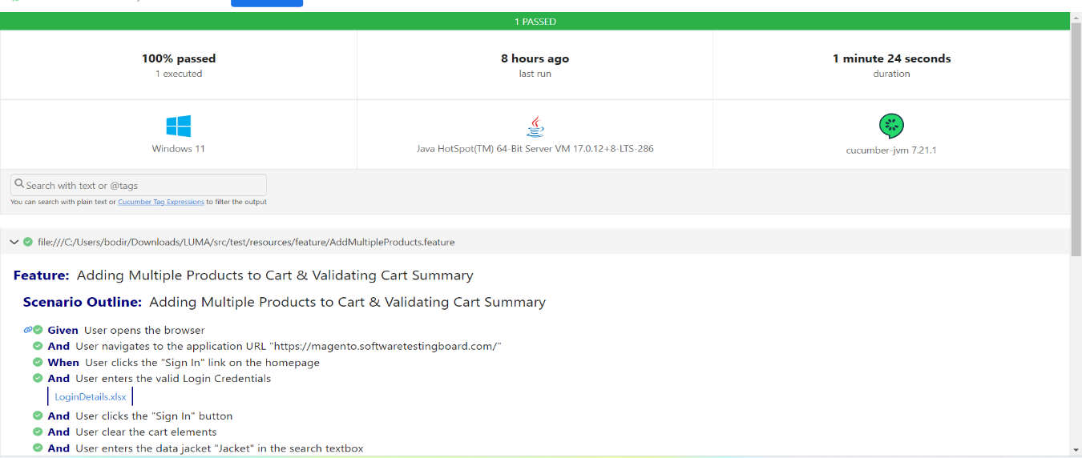
Scenario 4:Adding Multiple Products to Cart using Cucumber Framework, POM, Data properties, generate allure reports.
OUTPUT: Cucumber Reports:

Slide 11
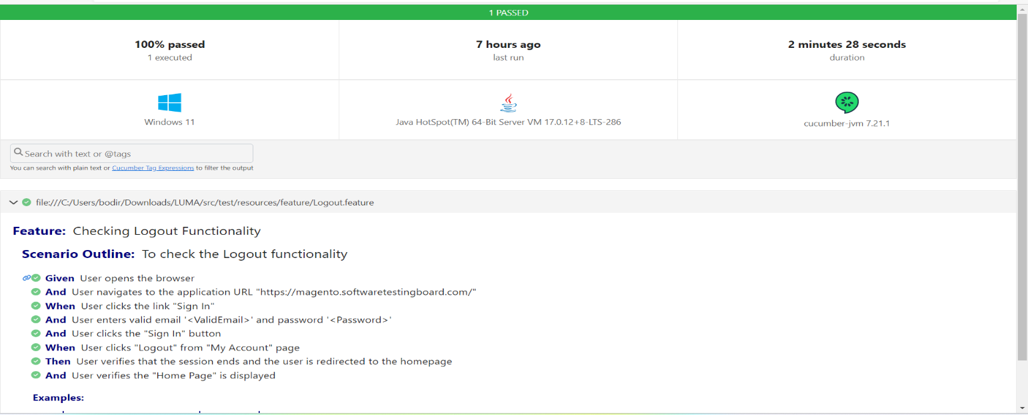
Scenario 5: Proceed to Checkout Using TestNG and generating allure reports.
OUTPUT: Cucumber Reports:

Slide 12
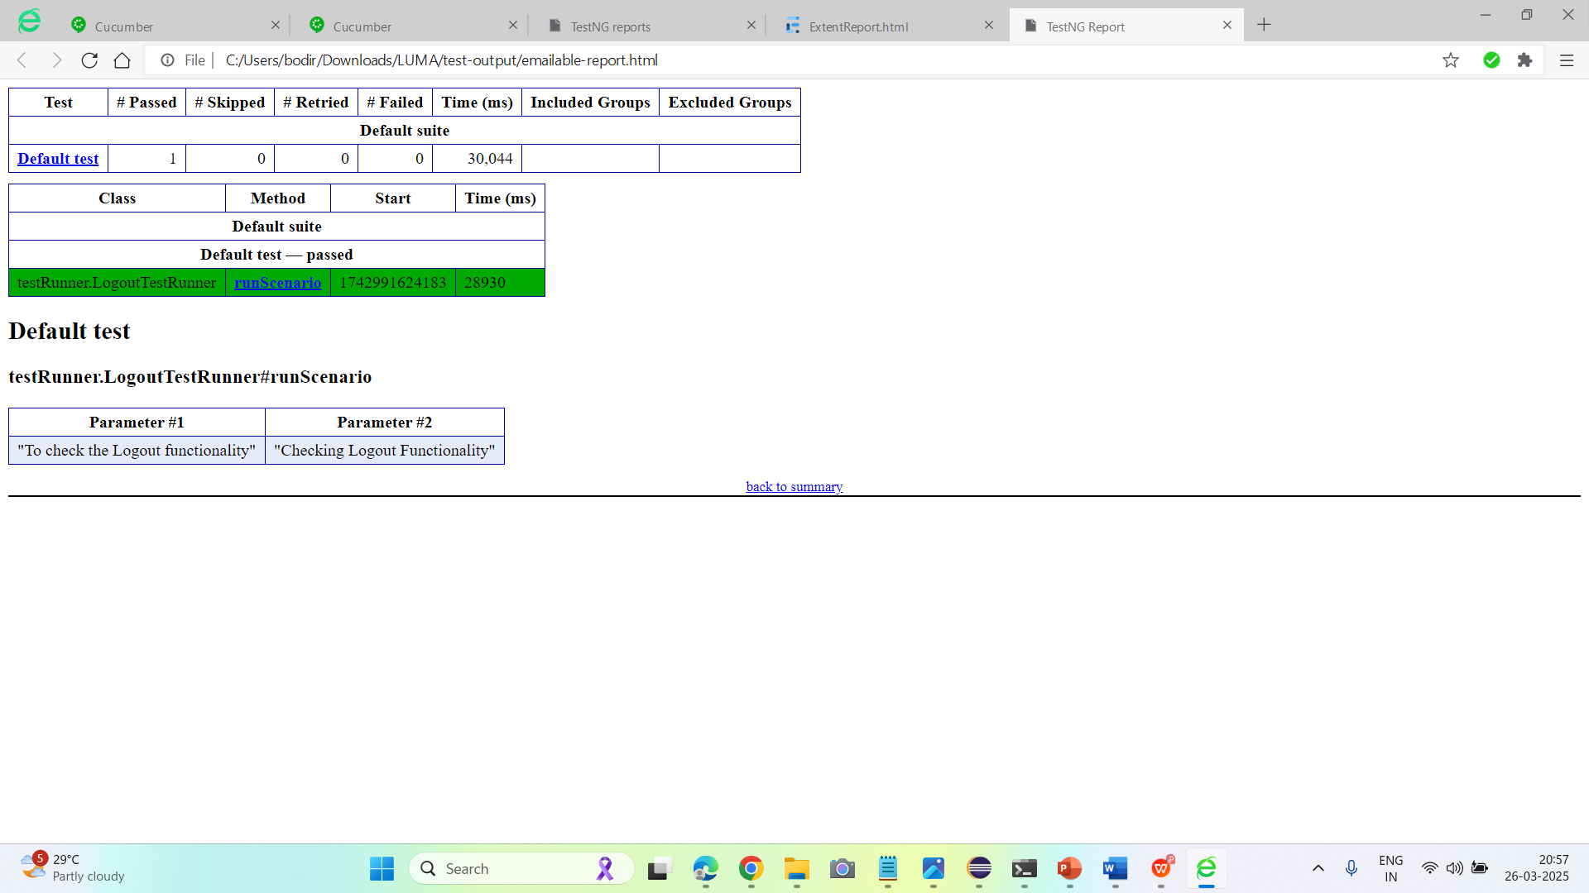
Scenario 6:Logout Using TestNG and generating allure report and Extent report.
OUTPUT: TestNG Reports:

Slide 13
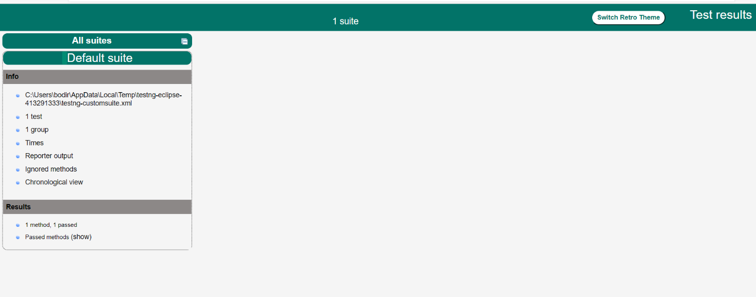
TestNG Report:

Slide 14
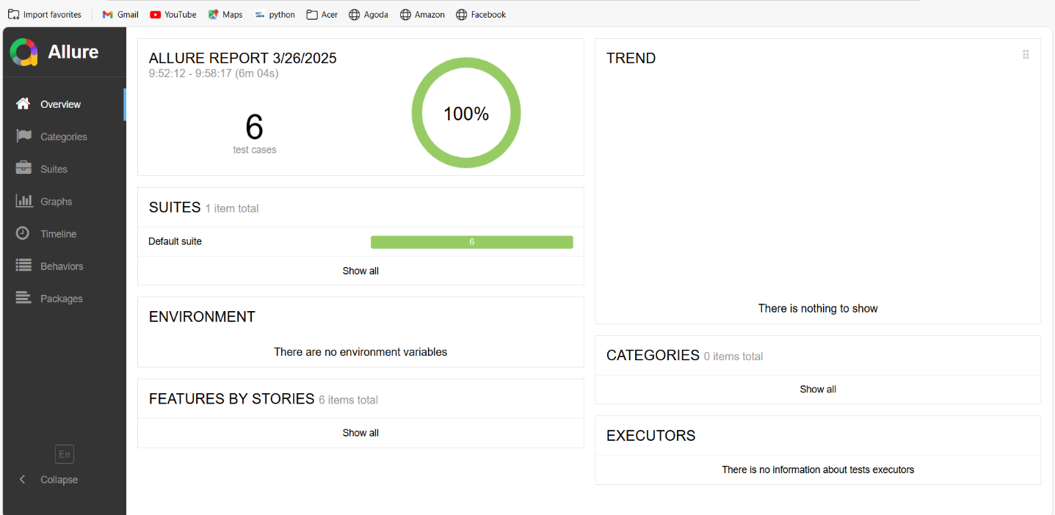
Allure Report: Allure Report is used for generating interactive and visually rich test execution reports with detailed logs, screenshots, and step-by-step execution history.

Slide 15
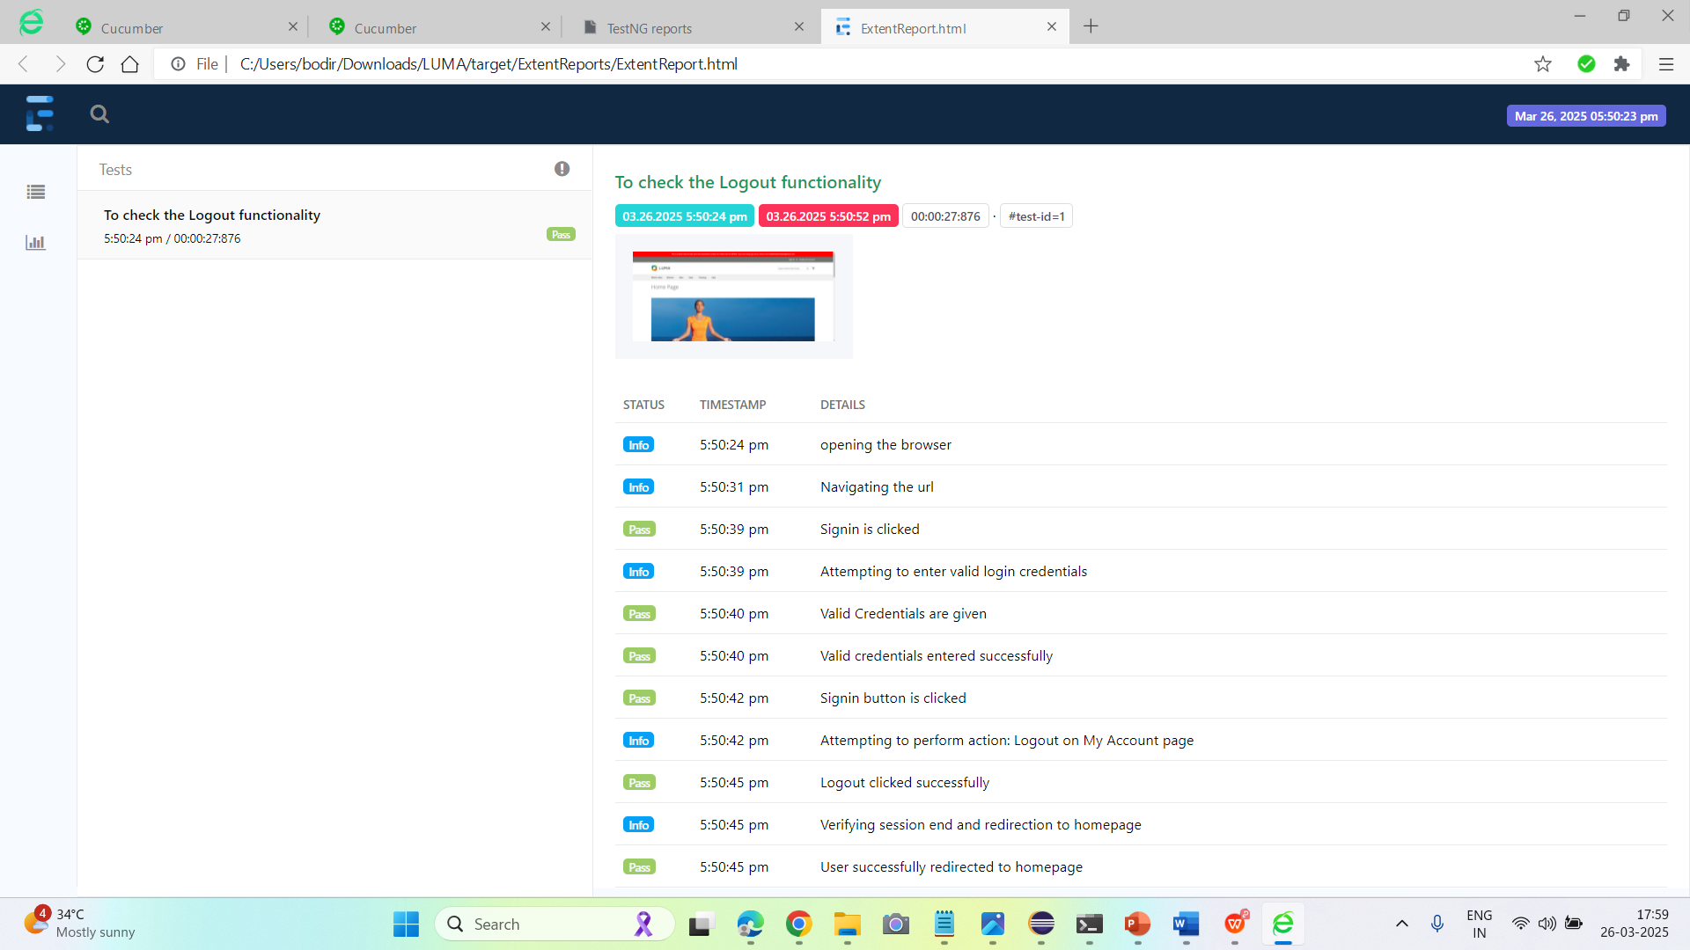
Extent Report: Extent Report are integrated to provide detailed interactive and visually appealed reports.

